Slide 1

Data-Limited Fisheries Toolkit
Evaluating management strategies for data-limited fish species
IOTC Case study 2, yellowfin tuna
May 2017

Slide 2
Background
Indian Ocean yellowfin tuna has been subject to stock assessment using Stock Synthesis 3 and is therefore a data-rich stock.
IOTC-2015-WPTT17-30_-_YFT_SS3_Stock_Assessment.pdf
Using an assessed stock:
Provides a basis for demonstrating toolkit functionality
Identifies areas where DLMtool requires other features
Investigates interim MP management
Quantifies the value of the various sources of data
Evaluates performance of harvest control rules (e.g. 40-10)

Slide 3
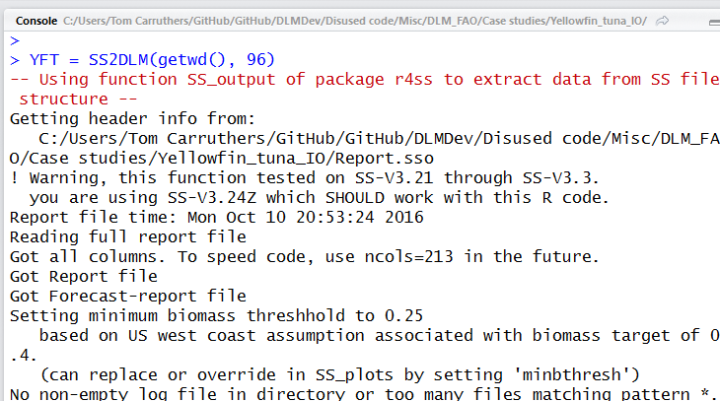
Specifying the operating model
We used a custom DLMtool function SS2DLM() to populate the parameters of the operating model.

Slide 4
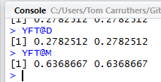
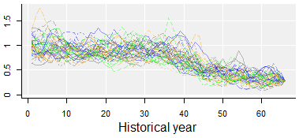
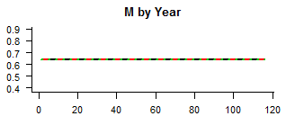
Its an MLE SS run so: depletion and M are known exactly

Slide 5
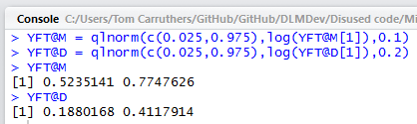
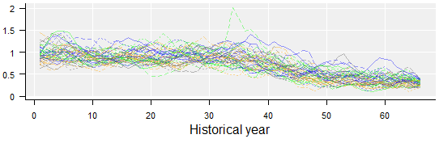
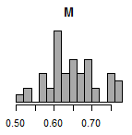
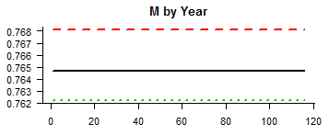
Artificially added uncertainty in these for MSE purposes (ideally this should be .covar or by .mcmc)

Slide 6
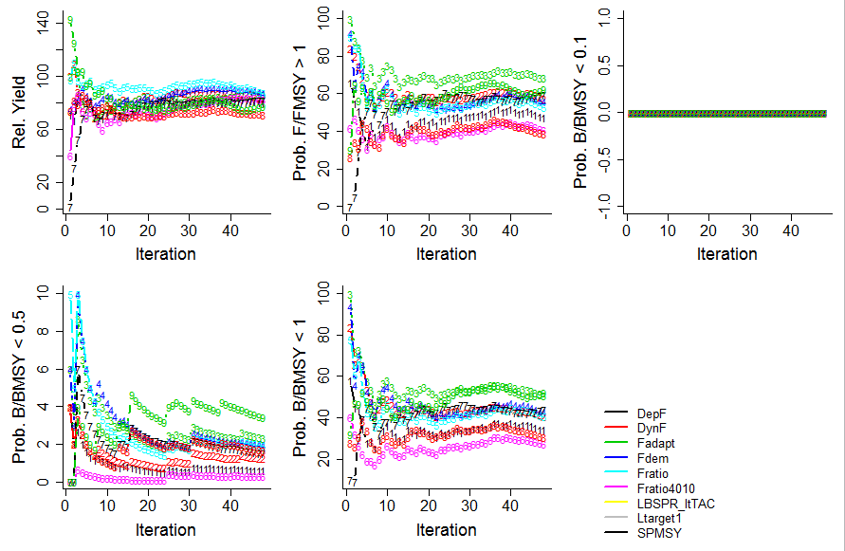
Checking convergence
*

Slide 7
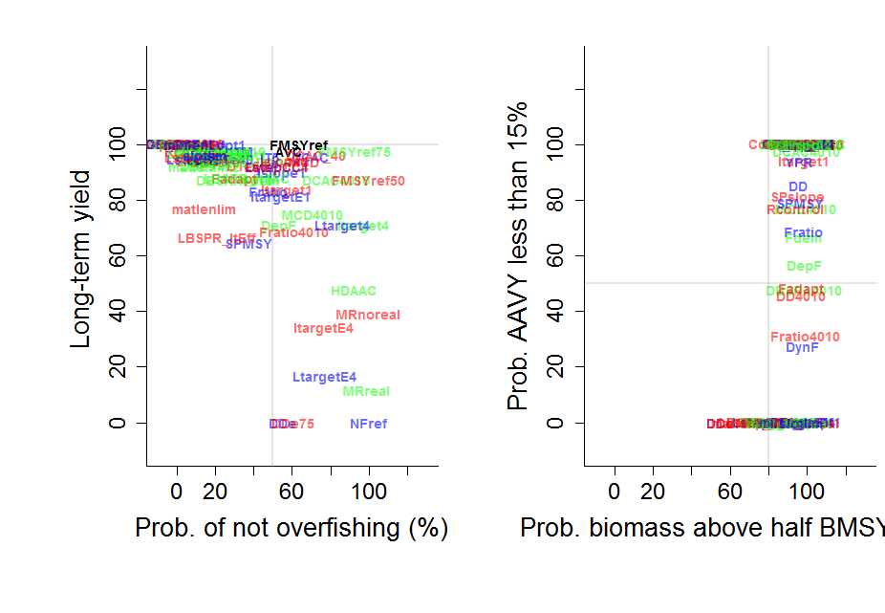
Initial satisficing with NOAA_plot()

Slide 8
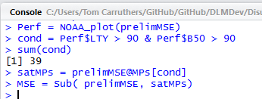
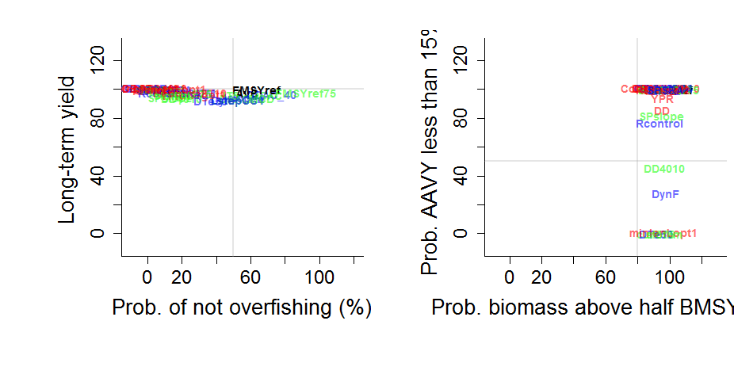
Initial satisficing

Slide 9

A new performance plot
Yield reference level is 75% of yield at FMSY
Biomass reference level is 75% of BMSY
Satisficing level for biomass (where the vertical line is drawn on the plot)
Satisficing level for yield relative to FMSY (where the horizontal line is drawn on the plot)

Slide 10
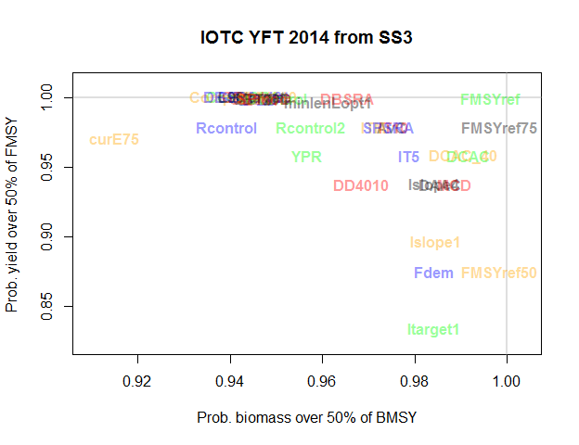
A new performance plot

Slide 11
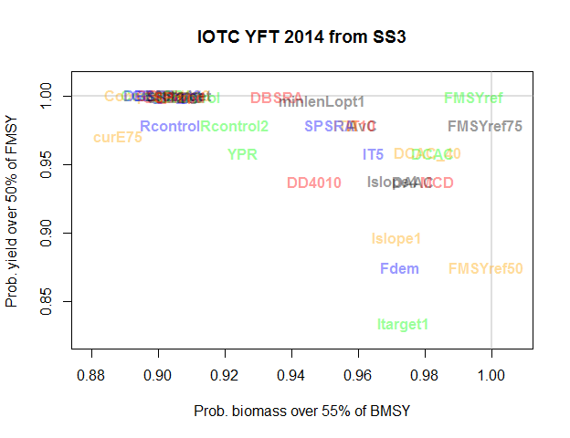
A new performance plot

Slide 12
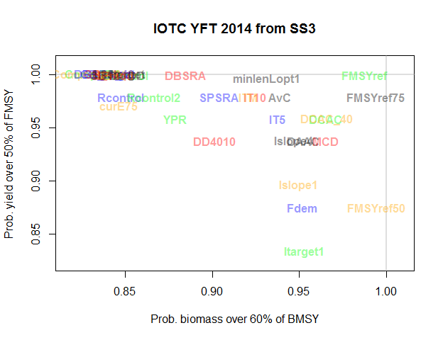
A new performance plot

Slide 13
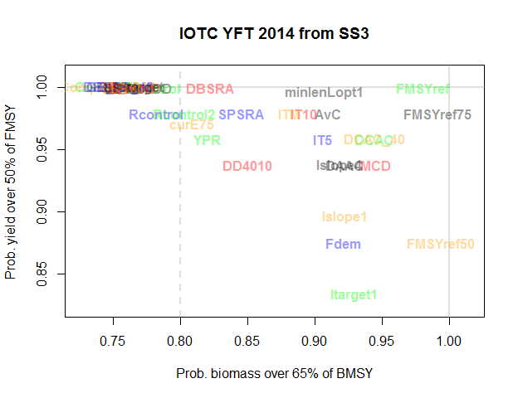
A new performance plot

Slide 14
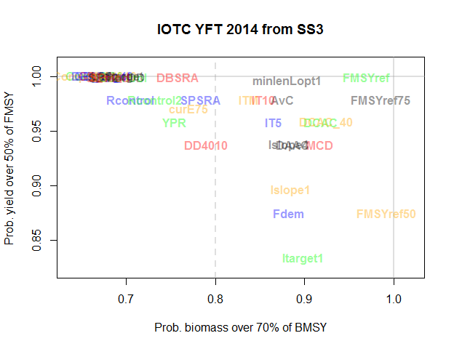
A new performance plot

Slide 15

A new performance plot

Slide 16
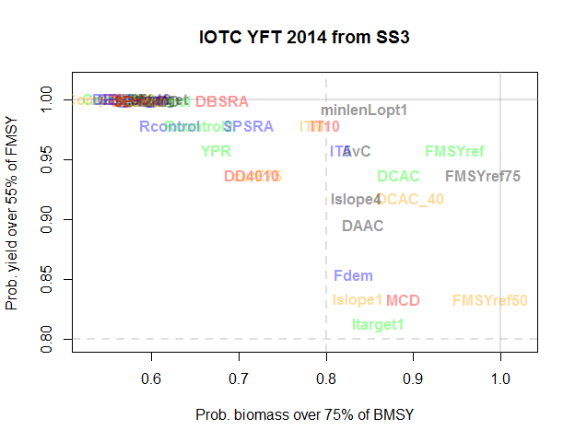
A new performance plot

Slide 17
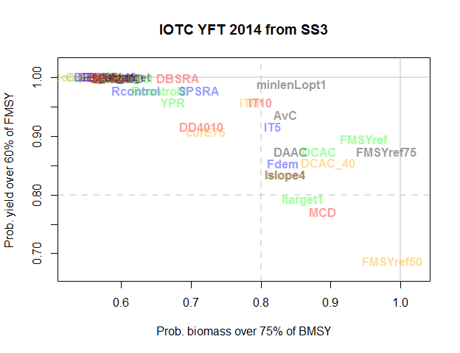
A new performance plot

Slide 18
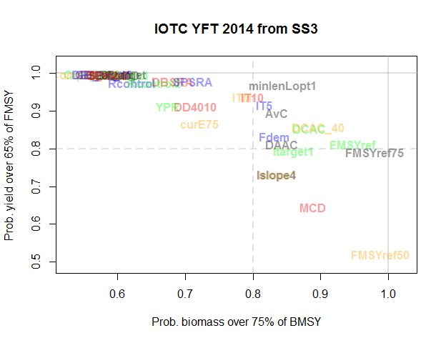
A new performance plot

Slide 19
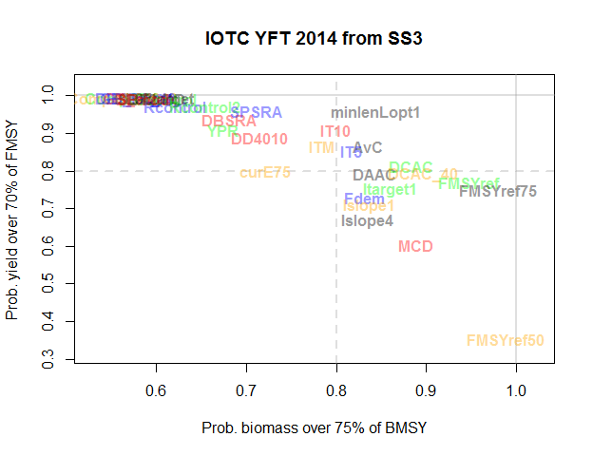
A new performance plot

Slide 20
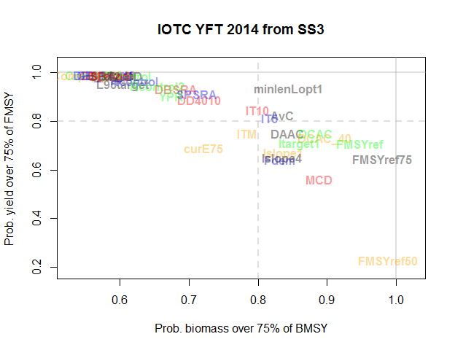
A new performance plot

Slide 21
Interpretation of the reference set
MP selection less important that in other fishery situations (ie good performance can be achieved by a range of MPs) due to several factors:
A highly resilient stock (high recruitment compensation)
Driven by recruitment strength (high variation in recruitment and high M)
At a reasonably productive stock state (not that depleted)

Slide 22
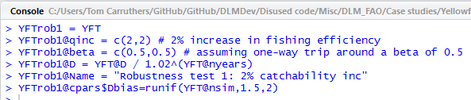
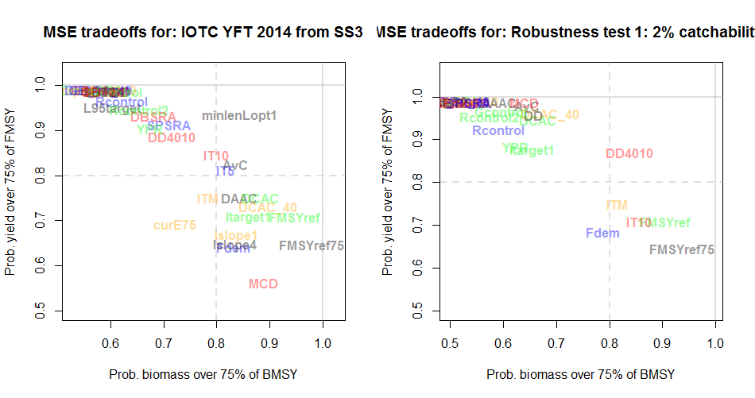
Robustness testing 1: indices and depletion

Slide 23
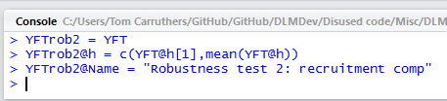
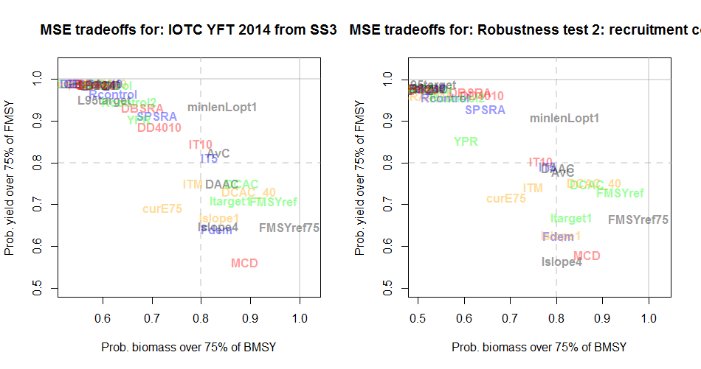
Robustness testing 2: lower recruitment compensation

Slide 24

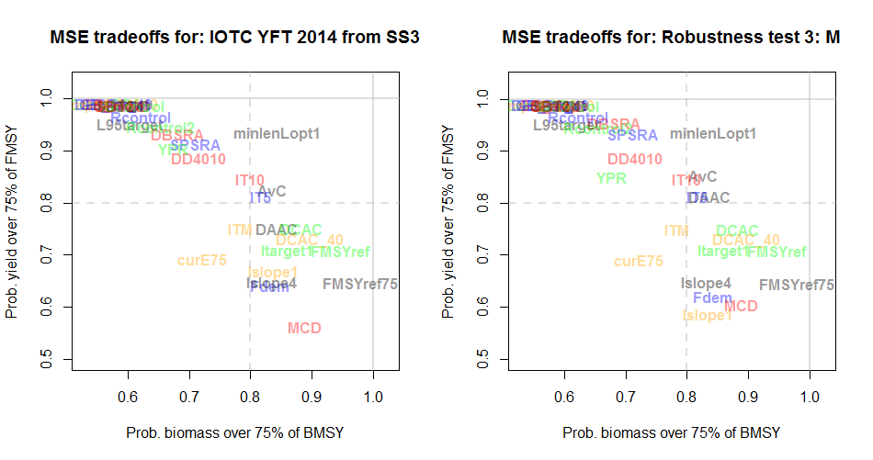
Robustness testing 3: lower M

Slide 25

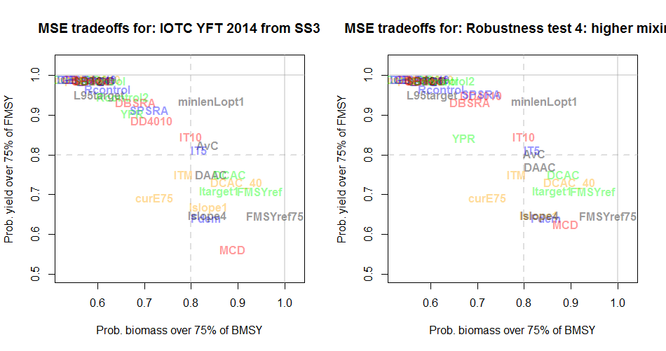
Robustness testing 4: greater stock mixing

Slide 26
Summary of robustness testing
Accounted for catchability changes in the CPUE could be the most important source of uncertainty and strongly affect the performance of the status quo (curE MPs)
Despite their dependence on indices of abundance the delay difference + 40-10 rule MP (DD4010) was robust to catchability changes.
Index target MPs (e.g. IT5, IT10) showed greatest resilience to changes in recruitment compensation.
Operating model dynamics are such that status-quo approaches such as Average Catch seem to perform acceptably.

Slide 27
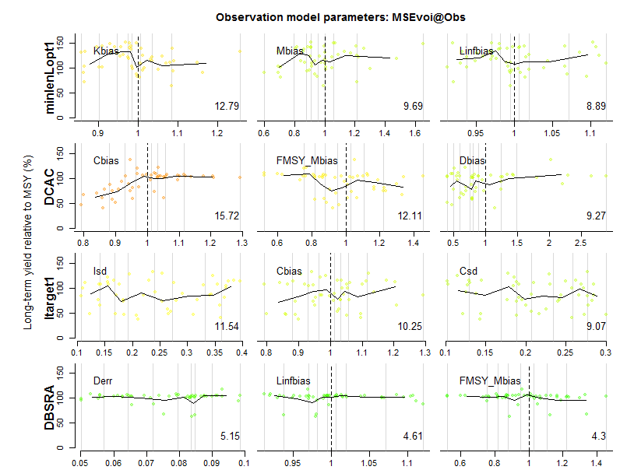
Value of information 1

Slide 28
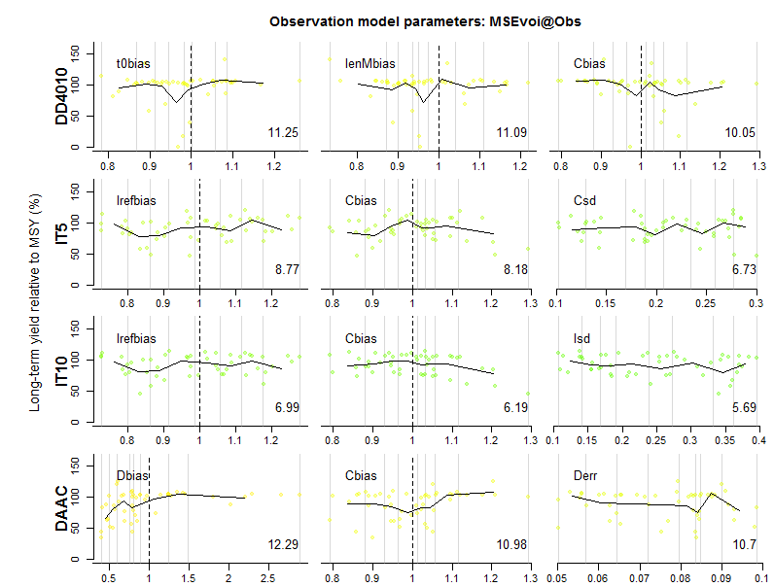
Value of information 2

Slide 29
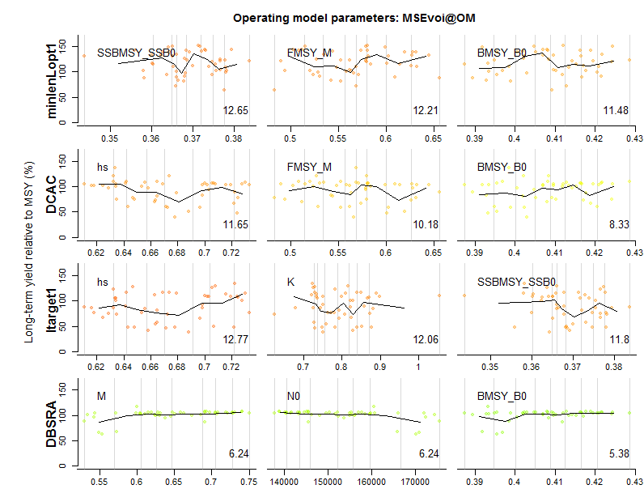
Cost of current uncertainties 1

Slide 30
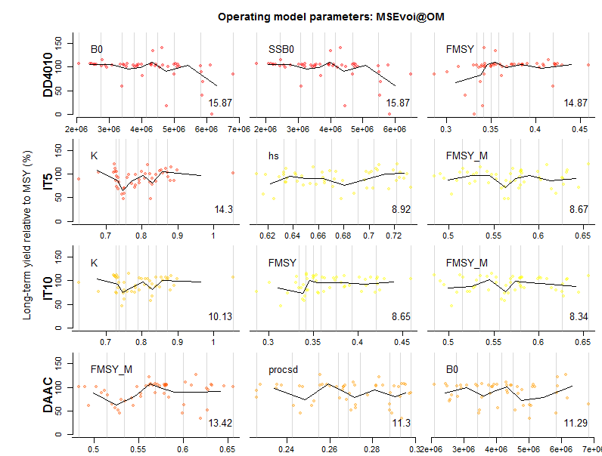
Cost of current uncertainties 2

Slide 31
Summary of VOI and CCU analyses
Performance is generally robust and unrelated to observation model properties (for this observation model, Generic_obs)
Exceptions include catch bias (Cbias) for mean catch MPs (e.g. DCAC, AvC) and depletion bias for any approaches that depend on depletion estimates (DAAC, DCAC).
Consistent with robustness testing, performance was flat with respect to operating model conditions.
Generally this simulation modelling suggests that for YFT data are sufficient as is knowledge about current conditions (extremely rare case!)

Slide 32

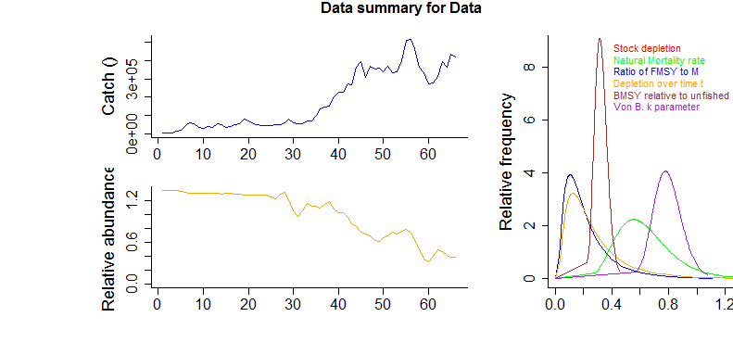
Using DLMtool to set catch advice
Coded a new function (in IOTC extras.R) called SS2Data()

Slide 33
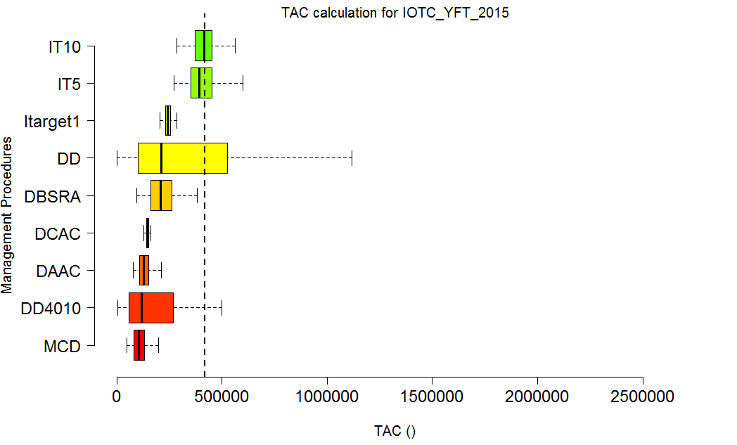
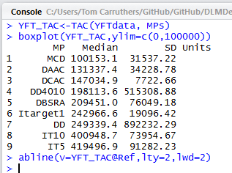
2015 catch

Slide 34
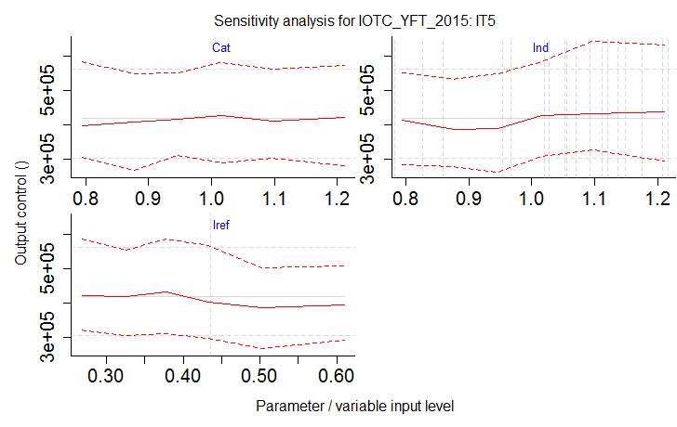
Sensitivity analysis

Slide 35
Conclusions
YFT is highly resilient
MP selection is less critical
Index target MPs are reasonably robust and TAC recommendations are relatively insensitive to the MP inputs.
There may be real strategic value in using an index target MP such as IT5 as an interim MP to update TACs between stock assessments since it is fast and cheap to do so.
VOI analysis and CCU analysis imply that from a strategic perspective there may not be much additional value to additional extensive data collection for YFT (shift to other species?)

Slide 36
The Director’s Cut: what control rule?

